Slide 1
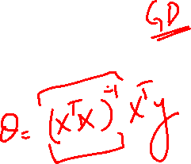
Outline
Previous Lecture
Linear Regression
Uni-Variate
Multi-Variate
Polynomial Regression
Normal Equations

Slide 2
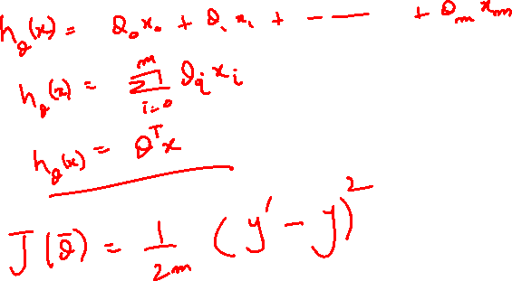
Todays Lecture
This Lecture
Logistic Regression

Slide 3
Logistic Regression
Classification

Slide 4
Classification
Email: Spam / Not Spam?
Online Transactions:
Fraudulent (Yes / No)?
Should a bank give a loan to person or NOT
Which people are more likely to vote
Which customers are more likely to buy a new product

Slide 5
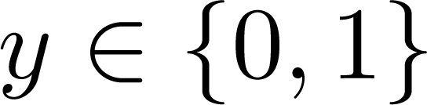
Classification
Should a student be admitted to a school or not
Whether people will subscribe to a magazine
Tumor: Malignant / Benign ?
0: “Negative Class” (e.g., benign tumor)
1: “Positive Class” (e.g., malignant tumor)
Supervise Learning: we know the correct answers
Classification: the outputs are discrete

Slide 6
Logistic Regression
Unlike Linear Regression, the dependent variable (y) can take a limited number of values only i.e, the dependent variable is categorical
When the number of possible outcomes is only two it is called Binary Logistic Regression.

Slide 7
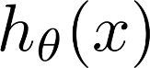
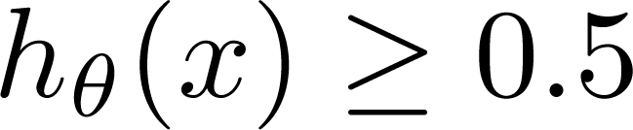
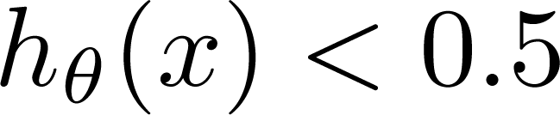
Threshold classifier output at 0.5:
If , predict “y = 1”
If , predict “y = 0”
(Yes) 1
Malignant ?
(No) 0
Tumor Size
Tumor Size
Notes:
Makes it susceptible to outliers

Slide 8
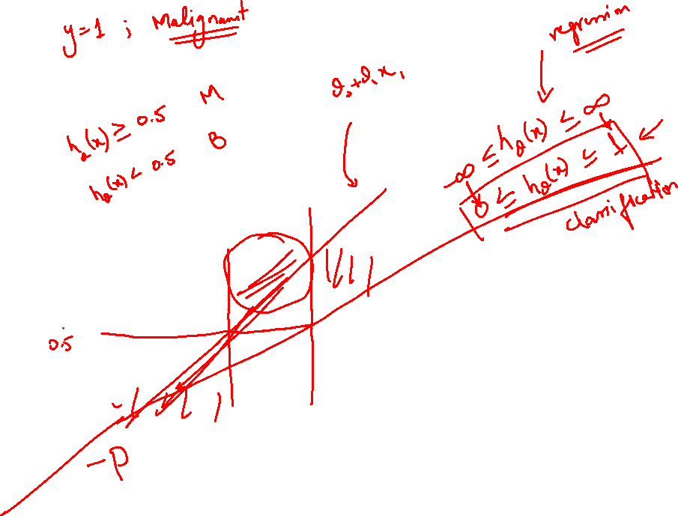
Threshold classifier output at 0.5:
If , predict “y = 1”
If , predict “y = 0”
(Yes) 1
Malignant ?
(No) 0
Tumor Size
Tumor Size
Notes:
Makes it susceptible to outliers

Slide 9
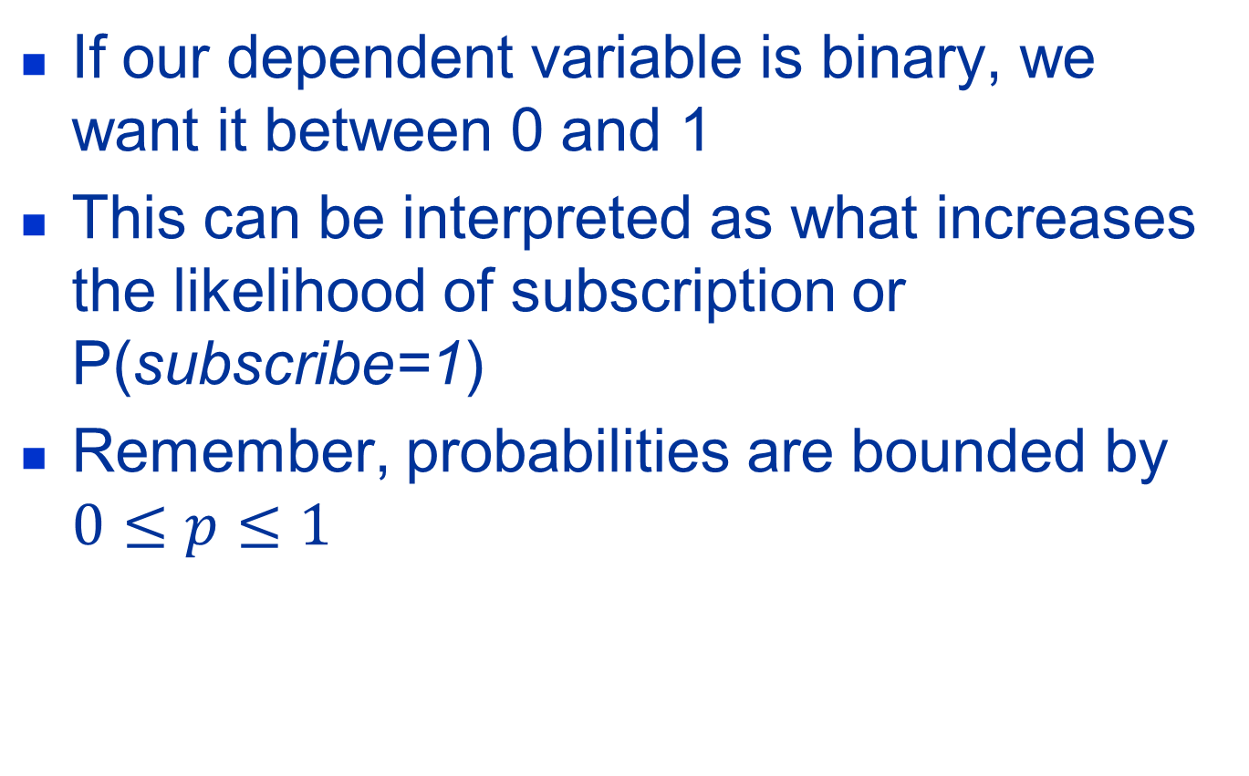

Interpreting this scenario
If our dependent variable is binary, we want it between 0 and 1
This can be interpreted as what increases the likelihood of subscription or P(subscribe=1)
Remember, probabilities are bounded by $0≤p≤1$

Slide 10
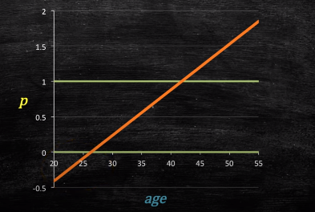
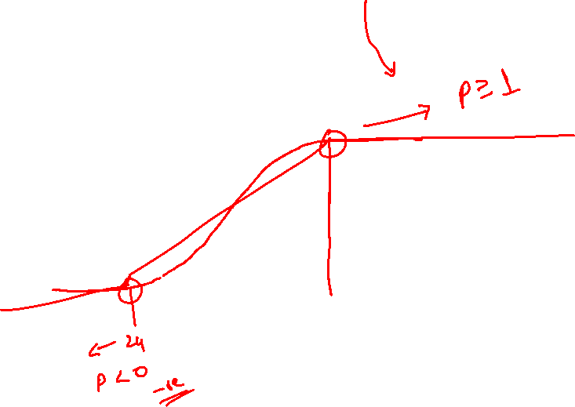
Using Linear Model

Slide 11
Using Linear Model

Slide 12
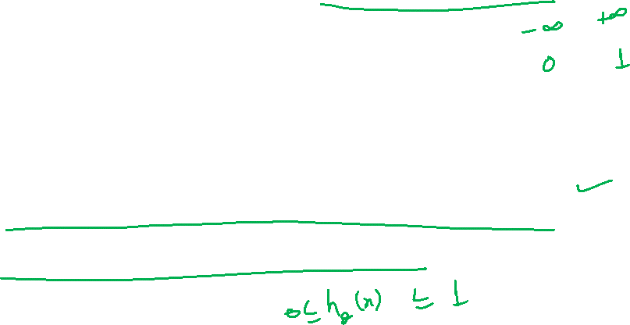
Restriction on Logistic Reg
If we take the weighted sum of inputs as the output as we do in Linear Regression, the value can be more than 1
we want a value between 0 and 1
we don’t output the weighted sum of inputs directly
we pass it through a function that can map any real value between 0 and 1

Slide 13
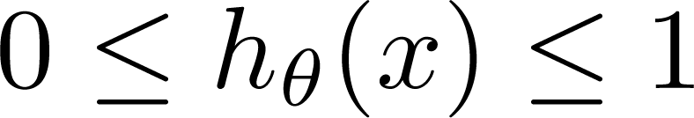
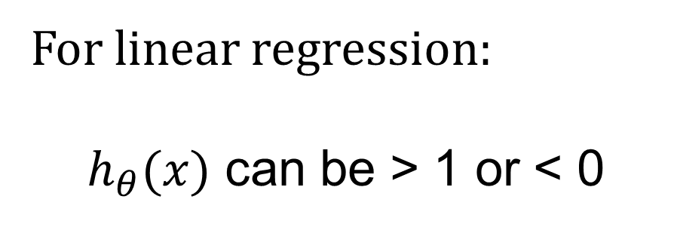
Restriction on LogReg
Classification: y = 0 or 1
For linear regression:
$h_{θ}(x)$ can be > 1 or < 0
Logistic Regression:

Slide 14
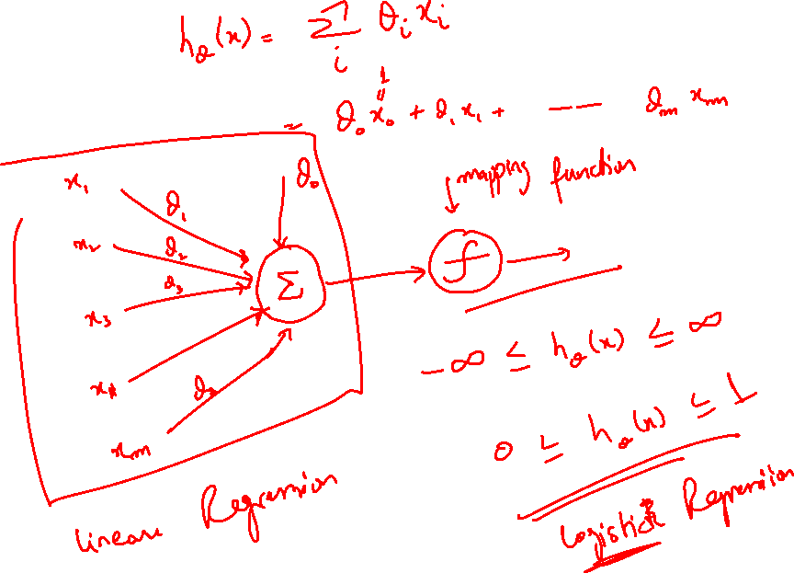

Slide 15
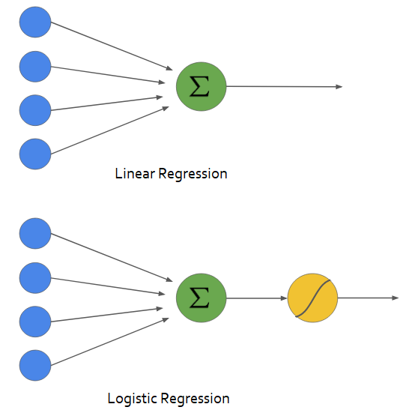
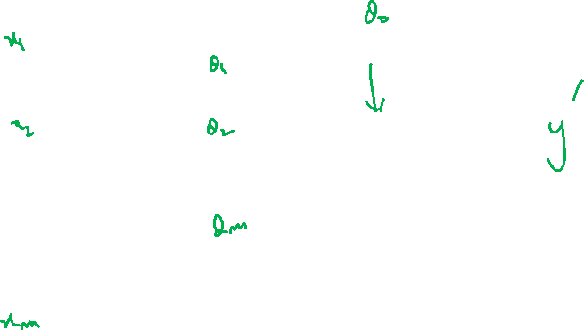

Slide 16
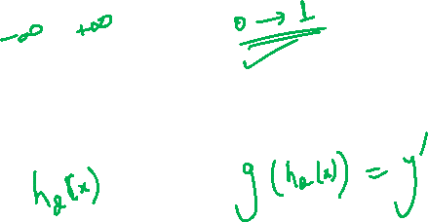

Slide 17
Activation Functions

Slide 18
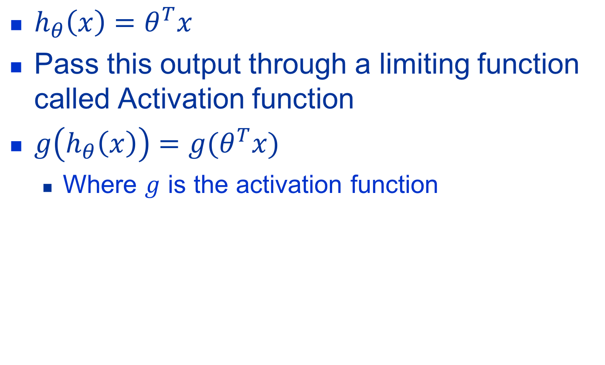
Activation Function
$h_{θ}\left(x\right)=θ^{T}x$
Pass this output through a limiting function called Activation function
$g\left(h_{θ}\left(x\right)\right)=g(θ^{T}x)$
Where $g$ is the activation function

Slide 19
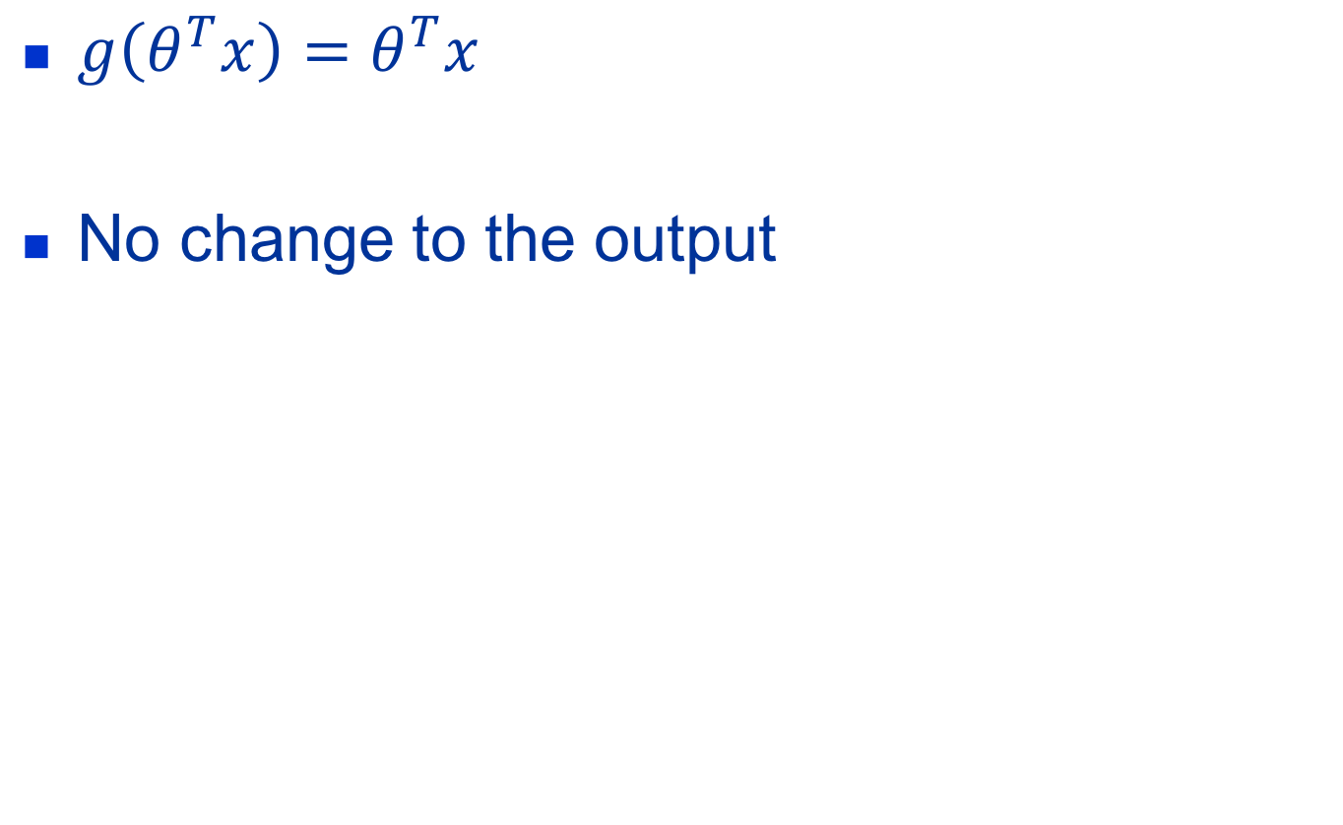
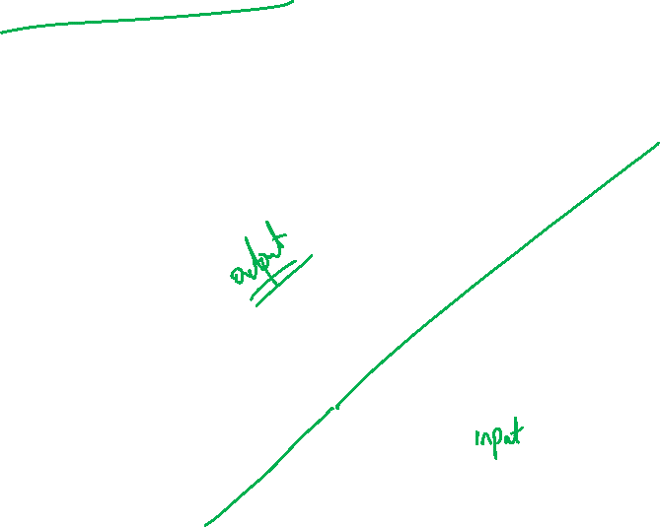
Linear Activation Function
$g\left(θ^{T}x\right)=θ^{T}x$
No change to the output
0
Notes:
Draw the figure here where on x axis we have thetaX and on y axis, there is g

Slide 20
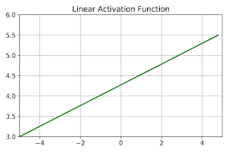

Slide 21
Linear Activation Function
Similar to the equation of a straight line
Gives a range of activations from -inf to +inf
Best suited to for simple regression problems, maybe housing price prediction
Demerits
The derivative of the linear function is the constant

Slide 22
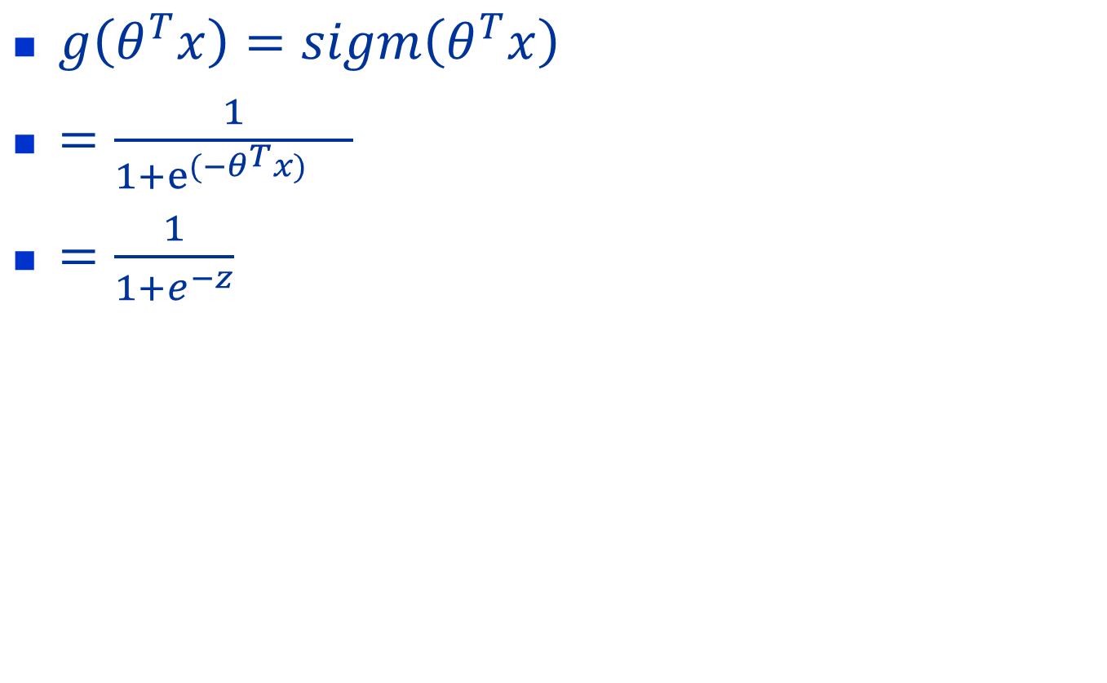
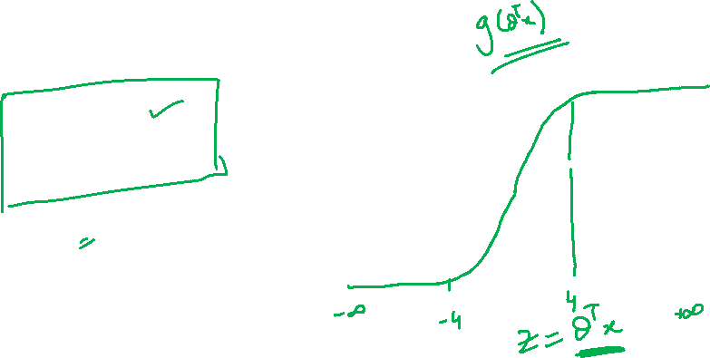
Sigmoid Activation
$g\left(θ^{T}x\right)=sigm\left(θ^{T}x\right)$
$=\frac{1}{1+e^{(−θ^{T}x)}{}}$
$=\frac{1}{1+e^{−z}}$
1
0.5
0
Notes:
Always output bw 0-1, Squashes the output h(x)
OR saturates the output bw 0-1
Output is always +ve
Strictly increasing func

Slide 23
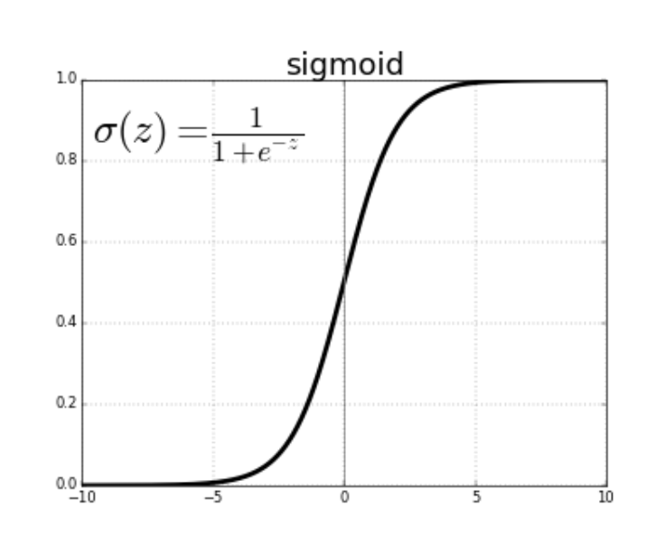

Slide 24
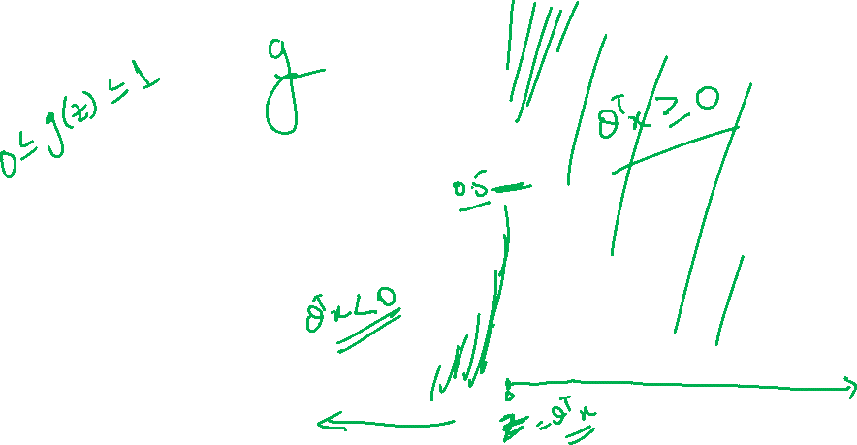

Slide 25
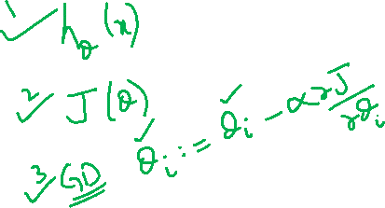
Logistic Regression
Hypothesis Representation

Slide 26
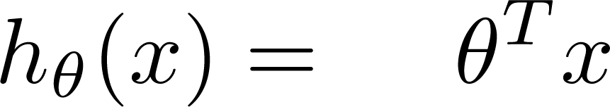
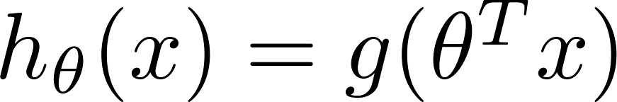
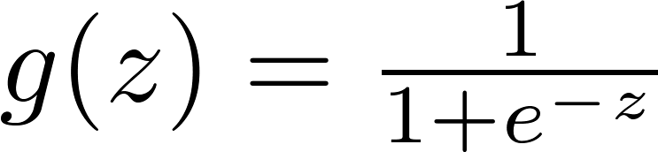
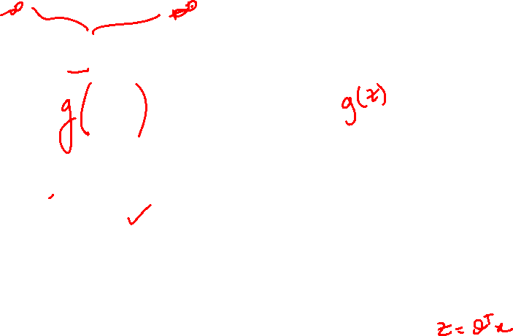
Logistic Regression Model
Want
1
0.5
Sigmoid function
Logistic function
0

Slide 27
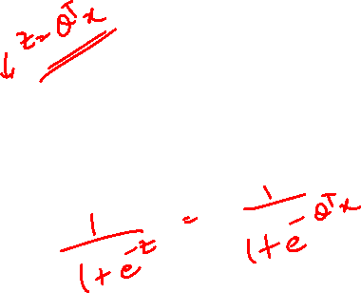
Sigmoid Func in Python
def sigmoid(Z): return 1/(1+np.exp(-Z))

Slide 28
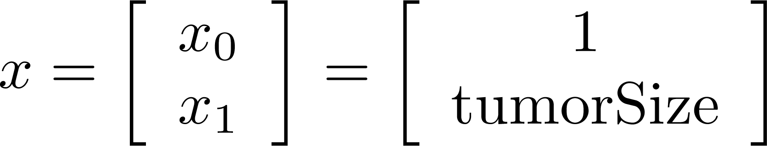
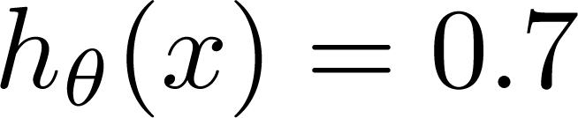
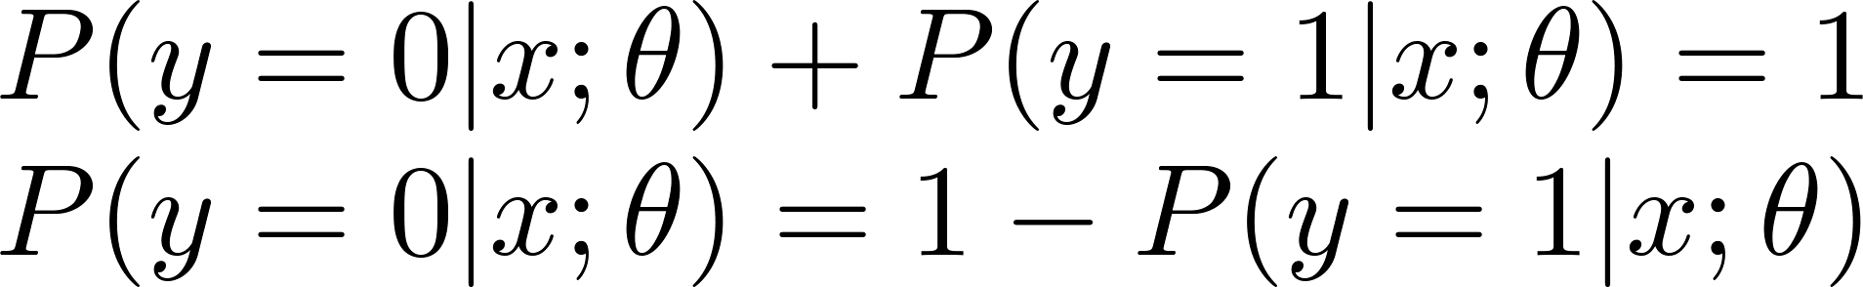
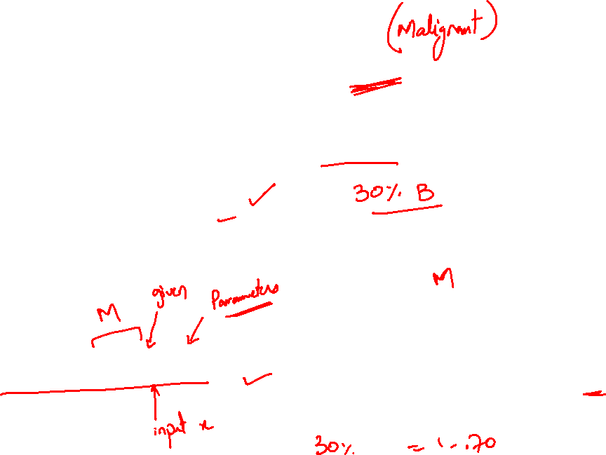
Interpretation of Hypothesis Output
= estimated probability that y = 1 on input x
Example: If
Tell patient that 70% chance of tumor being malignant
“probability that y = 1, given x,
parameterized by ”

Slide 29
Logistic Regression
Decision Boundary

Slide 30
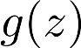
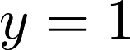
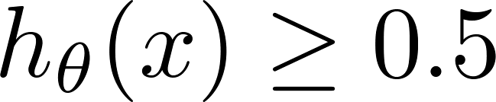
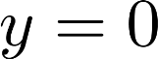
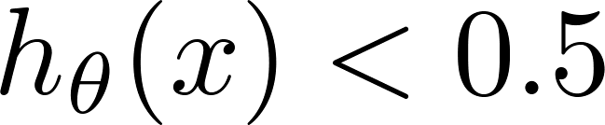

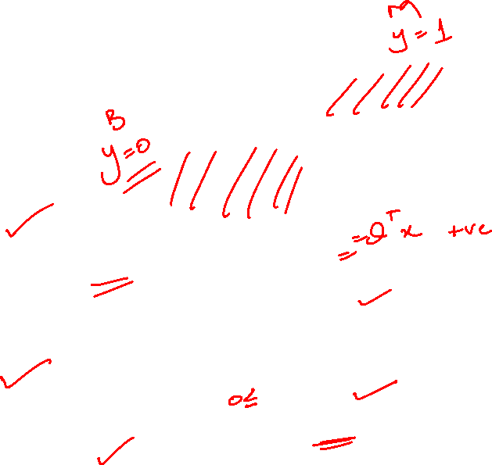
Logistic regression
1
0.5
0
z
Suppose predict “ “ if
θ^{T}x ≥ 0
g(z) ≥ 0.5
When z ≥ 0
and
g(x) < 0.5
When z< 0
predict “ “ if
θ^{T}x < 0

Slide 32
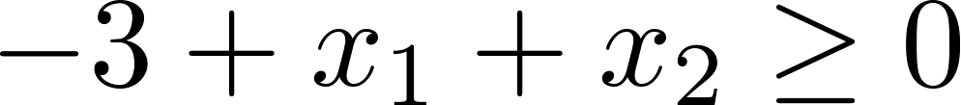
Decision Boundary
x₂
3
2
1
1
2
3
x₁
Predict:
y=1 if θ^{T}x ≥ 0
Notes:
Theta0=-3
Theta1=1
Theta2=1
Solve this equation. We get x1+x2 = 3 and we can get the decision boundary

Slide 33
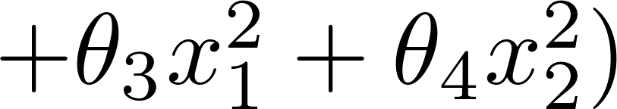
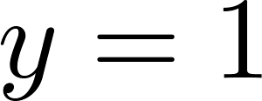
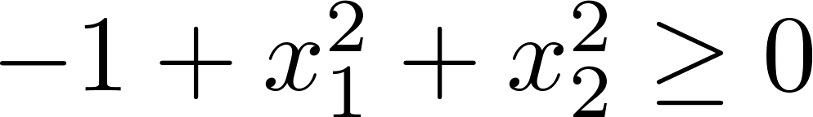
Non-linear decision boundaries
x₂
1
x₁
-1
1
-1
Predict “ “ if
x₂
x₁
Notes:
Theta = [-1;0;0;1;1]

Slide 34
Example Data Set
The data consists of marks of two exams for 100 applicants.
The target value takes on binary values 1,0.
1 means the applicant was admitted to the university
0 means the applicant didn't get an admission.

Slide 35
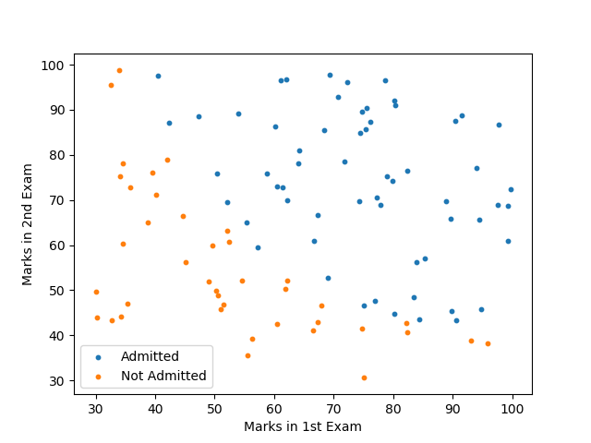
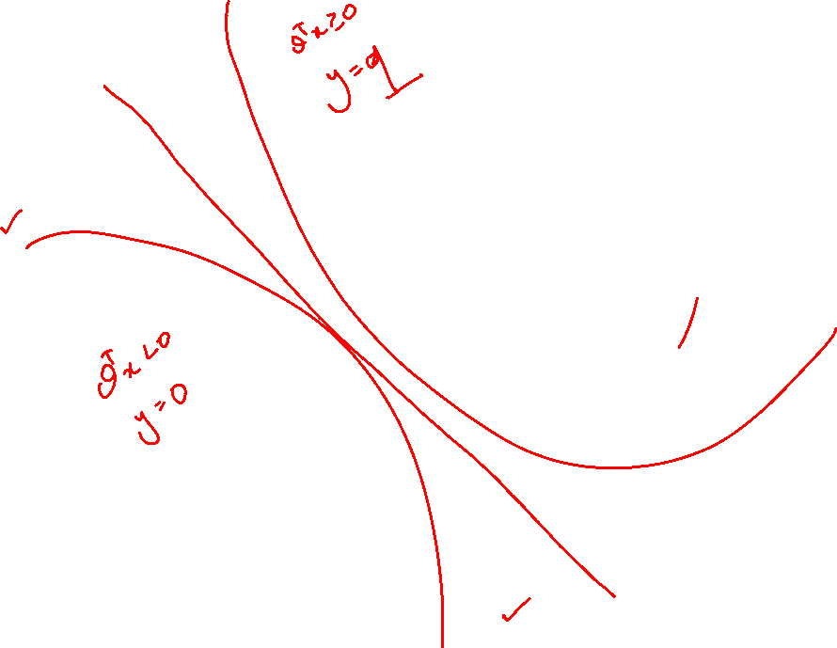

Slide 36
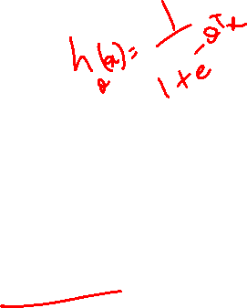
Logistic regression
1
0.5
Cost Function
0

Slide 37
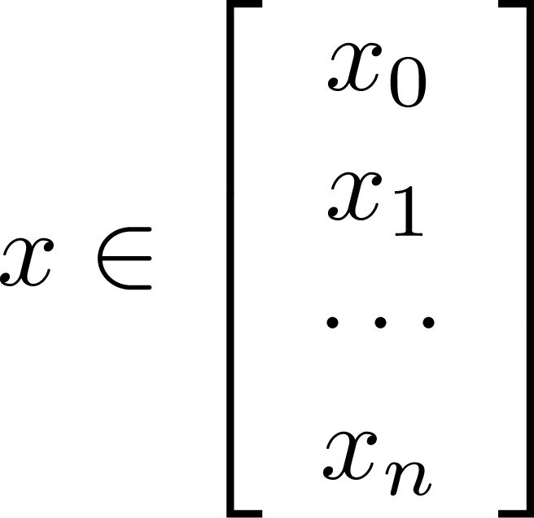
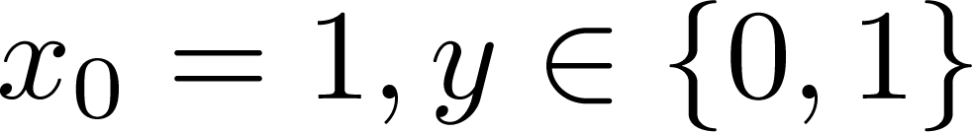


Training set:
m examples
How to choose parameters ?

Slide 38




Cost function
Linear regression:
“convex for Linear Reg”
“non-convex for Logistic Reg because of ”

Slide 39




Logistic regression cost function
If y = 1
0
1

Slide 40



Slide 41

Logistic regression cost function
If y = 0
0
1

Slide 42



Slide 43
Logistic Regression
Simplified Cost Function and Gradient Descent

Slide 44

Logistic regression cost function
We can combine both of equations using:
Notes:
Re-write the above equation in terms of estimated y (replace h(x) with y’.
For binary y, this equation is also called cross entropy or precisely as Bernulli cross entropy.

Slide 45


Logistic regression cost function
The cost for all the training examples denoted by J(θ) can be computed by taking the average over the cost of all the training samples
Notes:
Re-write the above equation in terms of estimated y (replace h(x) with y’.
For binary y, this equation is also called cross entropy or precisely as Bernulli cross entropy.

Slide 46





Logistic regression cost function
To fit parameters :
To make a prediction given new :
Output

Slide 47







Gradient Descent
Want :
Repeat
(simultaneously update all )

Slide 48



Gradient Descent
Want :
Repeat
(simultaneously update all )
Algorithm looks identical to linear regression!

Slide 49


Slide 50
Complete Derivative of Logistic function

Slide 51
Overfitting

Slide 52




Example: Linear regression (housing prices)
Overfitting: If we have too many features, the learned hypothesis may fit the training set very well ($J\left(θ\right)=\frac{1}{2m}\sum_{i}{(h_{θ}{\left(x^{\left(i\right)}−y^{\left(i\right)}\right)}^{2}≈0}$), but fail to generalize to new examples (predict prices on new examples).
Price
Price
Price
Size
Size
Size
Notes:
Linear model has high ‘bias’. Inspite of the evidence given by the data, it has preconception about the model of the data.

Slide 53




Example: Logistic regression
( = sigmoid function)
x₂
x₂
x₂
x₁
x₁
x₁

Slide 54








How to Visualise overfitting:
size of house
no. of bedrooms
Price
no. of floors
age of house
average income in neighborhood
Size
kitchen size
Plot the function

Slide 55


Addressing overfitting:
Options:
Reduce number of features.
Manually select which features to keep.
Model selection algorithm (later in course).
Regularization.
Keep all the features, but reduce magnitude/values of parameters $θ_{j}$.
Works well when we have a lot of features, each of which contributes a bit to predicting $y$.

Slide 59




Intuition
Price
Price
Size of house
Size of house
Suppose we penalize and make , really small.

Slide 60





Regularization.
Small values for parameters
“Simpler” hypothesis
Less prone to overfitting
Housing:
Features:
Parameters:

Slide 61



Regularization.
This function has two objective
Fitting the data – captured by first term
Good generalisation by penalising the parameters – captured by second term
Price
Size of house

Slide 62



In regularized linear regression, we choose to minimize
What if is set to an extremely large value (perhaps for too large for our problem, say )?
Price
Size of house

Slide 63
Regularised Linear Regression
Formulation of Cost Function

Slide 64

Regularized linear regression

Slide 65






Gradient descent
Repeat

Slide 66


Normal equation

Slide 67

Matlab Example: λ=0

Slide 68

λ= 1

Slide 69


λ = 10

Slide 70
Regularisation
Regularised Logistic Regression

Slide 71




Regularized logistic regression.
x₂
x₁
Cost function:

Slide 72

Gradient descent
Repeat
Notes:
Add –λ/m θj in the upate function

Slide 73



Slide 74


Slide 75


Slide 77
Multi-Class Classification

Slide 78

Binary classification:
Multi-class classification:
x₂
x₂
x₁
x₁

Slide 79


x₂
One-vs-all (one-vs-rest):
x₁
x₂
x₂
x₁
x₁
Class 1:
Class 2:
Class 3:
x₂
x₁

Slide 81
https://chrisalbon.com/code/machine_learning/logistic_regression/one-vs-rest_logistic_regression/

Slide 83




One-vs-all
Train a logistic regression classifier for each class to predict the probability that .
On a new input , to make a prediction, pick the class that maximizes

Slide 84
One vs Rest
jth classifier is trained with all the training data in the jth class given +ve labels, and the rest given –ve labels.
Each node is a classifier
Class of x_i = argmax J(x_i)

Slide 85
One vs Rest
Benefit:
only train M classifiers
Drawback:
Deal with unbalanced data
Down sampling or upsampling

Slide 86
One vs One
Max-wins voting
Construct M(M-1)/2 binary classifiers
Each classifier votes for the class

Slide 87
Directed Acyclic Graph
Hierarchical classifier
Construct M(M-1)/2 binary classifiers
Do not have to deal with unbalanced data

Slide 88
UnBalanced Decision Tree
Re-arranged version of 1VR
Better handling of Imbalanced data

Slide 89
Activation Functions

Slide 90
Activation Function
$h_{θ}\left(x\right)=θ^{T}x$
Pass this output through a limiting function called Activation function
$g\left(h_{θ}\left(x\right)\right)=g(θ^{T}x)$
Where $g$ is the activation function

Slide 91
Linear Activation Function
$g\left(θ^{T}x\right)=θ^{T}x$
No change to the output
0
Notes:
Draw the figure here where on x axis we have thetaX and on y axis, there is g

Slide 93
Linear Activation Function
Similar to the equation of a straight line
Gives a range of activations from -inf to +inf
Best suited to for simple regression problems, maybe housing price prediction
Demerits
The derivative of the linear function is the constant

Slide 94

Rectified Linear Activation(ReLU)
$g\left(θ^{T}x\right)=reclin (θ^{T}x)$
$g\left(θ^{T}x\right)=max⁡(0,θ^{T}x)$
0
Notes:
Output is always +ve, simply clips the negative values

Slide 95

Rectified Linear Unit (ReLU)
The formula is pretty simple,
if the input is a positive value, then that value is returned otherwise 0

Slide 96

LeakyReLU
LeakyReLU is a slight variation of ReLU.
For positive values, it is same as ReLU, returns the same input,
For other values, a constant 0.01 with input is provided.

Slide 97
Sigmoid Activation
$g\left(θ^{T}x\right)=sigm\left(θ^{T}x\right)$
$=\frac{1}{1+e^{(−θ^{T}x)}{}}$
$=\frac{1}{1+e^{−z}}$
1
0.5
0
Notes:
Always output bw 0-1, Squashes the output h(x)
OR saturates the output bw 0-1
Output is always +ve
Strictly increasing func

Slide 99

Hyperbolic Tangent Activation
$g\left(θ^{T}x\right)=\tanh{(θ^{T}x)}$
$=\frac{\exp\left(θ^{T}x\right)−exp⁡(−θ^{T}x)}{\exp\left(θ^{T}x\right)+exp⁡(−θ^{T}x)}$
$=\frac{\exp\left(2∗θ^{T}x\right)−1}{\exp\left({2∗θ}^{T}x\right)+1}$
1
0.5
0
-1
Notes:
Saturates o/p bw -1 to +1

Slide 100


Slide 101
SoftMax
Softmax activation function returns probabilities of the inputs as output.
The probabilities will be used to find out the target class.
Final output will be the one with the highest probability.
The sum of all these probabilities must be equal to 1.
This is mostly used in classification problems, preferably in multiclass classification.

Slide 102



Slide 103
Steps for Soft Max
Exponentiate every element of the output layer and sum the results (around 181.73 in this case)
Take each element of the output layer, exponentiate it and divide by the sum obtained in step 1 (exp(1.3) / 181.37 = 3.67 / 181.37 = 0.02)

Slide 104
Announcements
Reading Assignment
Logistic Regression
Reading: Chapter 8
Kevin Murphy
Wikipedia
https://en.wikipedia.org/wiki/Logistic_regression
Youtube
Video 7: Logistic Regression - Introduction
https://youtu.be/gNhogKJ_q7U

Slide 105
Next Lecture
Feature Selection
Feature Reduction

Slide 106
Feature Selection

Slide 107
Why Feature Selection
The curse of Dimensionality

Slide 108
Feature Selection
Select features having high discrimination power while ignoring or paying less attention to the rest.
Given a set of n features, the role of feature selection is to select a subset of size k (k < n) that leads to the smallest classification error.
What constitutes a good set of features for classification?

Slide 109
Why is feature selection important?
Eliminates redundant and irrelevant features.
Classifier requires less training examples for training (i.e., curse of dimensionality).
Faster and more accurate classification.

Slide 110
Feature Selection Methods
Feature selection is an optimization problem.
Search the space of possible feature subsets.
Pick the one that is optimal or near-optimal with respect to a certain criterion.
Search strategies
Exhaustive
Heuristic
Randomized
Evaluation strategies
- Filter methods
- Wrapper methods

Slide 111

Exhaustive Search
Assuming m features, an exhaustive search would require:
Examining all $\left({n \atop k}\right)$ possible subsets of size k.
Selecting the subset that performs the best according to the evaluation function.
The number of subsets grows combinatorialy, making exhaustive search impractical.
Iterative procedures are often used but they cannot guarantee the selection of the optimal subset.

Slide 112
Naïve Search
Sort the given n features in order of their probability of correct recognition.
Select the top k features from this sorted list.
Disadvantage
Feature correlation is not considered.
Best pair of features may not even contain the best individual feature.

Slide 113

Feature Selection using Genetic Algorithms (GAs) (randomized search)
GAs provide a simple, general, and powerful framework
for feature selection.
Classifier
Pre-
Processing
Feature Extraction
Feature Subset
Feature Subset
Feature Selection
(GA)

Slide 114
Evaluation Strategies
Filter Methods
Evaluation is independent of the classification algorithm or its error criteria.
Wrapper Methods
Evaluation uses a criterion related to the classification algorithm.
Wrapper methods provide more accurate solutions than filter methods, but in general are more computationally expensive.

Slide 115

Sequential forward selection (SFS) (heuristic search)
First, the best single feature is selected (i.e., using some criterion function).
Then, pairs of features are formed using one of the remaining features and this best feature, and the best pair is selected.
Next, triplets of features are formed using one of the remaining features and these two best features, and the best triplet is selected.
This procedure continues until evaluation criterion increases monotonically or a predefined number of features are selected.
SFS performs
best when the
optimal subset is
small.

Slide 116

SFS Algorithm

Slide 117

Example
Results of sequential forward feature selection for classification of a satellite image using 28 features. x-axis shows the classification accuracy (%) and y-axis shows the features added at each iteration (the first iteration is at the bottom). The highest accuracy value is shown with a star.

Slide 118

Sequential backward selection (SBS) (heuristic search)
First, the criterion function is computed for all d features.
Then, each feature is deleted one at a time, the criterion function is computed for all subsets with d − 1 features, and the worst feature is discarded.
Next, each feature among the remaining d − 1 is deleted one at a time, and the worst feature is discarded to form a subset with d − 2 features.
This procedure continues until a predefined number of features are left.
SBS performs
best when the
optimal subset is
large.

Slide 119

Example
Results of sequential backward feature selection for classification of a satellite image using 28 features. x-axis shows the classification accuracy (%) and y-axis shows the features removed at each iteration (the first iteration is at the bottom). The highest accuracy value is shown with a star.

Slide 120
Plus-L minus-R selection (LRS)
A generalization of SFS and SBS
If L>R, LRS starts from the empty set and repeatedly adds L features and removes R features.
If L<R, LRS starts from the full set and repeatedly removes R features and adds L features.
Comments
LRS attempts to compensate for the weaknesses of SFS and SBS with some backtracking capabilities.
How to choose the optimal values of L and R?

Slide 121
Sequential floating selection (SFFS and SFBS)
An extension to LRS with flexible backtracking capabilities
Rather than fixing the values of L and R, floating methods determine these values from the data.
The dimensionality of the subset during the search can be thought to be “floating” up and down
There are two floating methods:
Sequential floating forward selection (SFFS)
Sequential floating backward selection (SFBS)
P. Pudil, J. Novovicova, J. Kittler, Floating search methods in feature selection, Pattern Recognition Lett. 15 (1994) 1119–1125.

Slide 122
Sequential floating selection (SFFS and SFBS)
SFFS
Sequential floating forward selection (SFFS) starts from the empty set.
After each forward step, SFFS performs backward steps as long as the objective function increases.
SFBS
Sequential floating backward selection (SFBS) starts from the full set.
After each backward step, SFBS performs forward steps as long as the objective function increases.

Slide 123

SFFS

Slide 124

Bidirectional Search (BDS)
BDS applies SFS and SBS simultaneously:
SFS is performed from the empty set
SBS is performed from the full set
To guarantee that SFS and SBS converge to the same solution
Features already selected by SFS are not removed by SBS
Features already removed by SBS are not selected by SFS

Slide 125
Dimensionality Reduction

Slide 126
Motivation
Doing Exhaustive search is very expensive – non-feasible
Doing Wrapper based feature selection (SFS,SBS, SFFS, etc ) again very expensive
Doing filter based feature selection is suboptimal
Solution??? Try to automate this method

Slide 127
Spread of Data
Often data varies in only some limited directions
Can’t spot low dimensional data by looking at numbers

Slide 128

Example

Slide 129


Slide 130


Slide 131


Slide 132


Slide 133


Slide 134


Slide 135
Dimensionality Reduction
Reduce dimensions by projecting onto low dimensional subspace with maximum variation
You can consider this as dropping non-necessary axis and rotating the remaining axis

Slide 136









Data Compression
Reduce data from
2D to 1D

Slide 137
PCA is not linear regression

Slide 138
Principal Component Analysis
Most common form of dimensionality reduction
The new variables/dimensions
Are linear combinations of the original ones
Are uncorrelated with one another
Orthogonal in original dimension space
Capture as much of the original variance in the data as possible
Are called Principal Components

Slide 139
Orthogonal Axis that capture the max variance of the data

Slide 140

What are the new axes?
Orthogonal directions of greatest variance in data
Projections along PC1 discriminate the data most along any one axis

Slide 141
Principal Components
• First principal component is the direction of greatest
variability (covariance) in the data
• Second is the next orthogonal (uncorrelated) direction of greatest variability
– So first remove all the variability along the first
component, and then find the next direction of
greatest variability
• And so on …

Slide 142
Principal Components Analysis (PCA)
Principle
Linear projection method to reduce the number of parameters
Transfer a set of correlated variables into a new set of uncorrelated variables
Map the data into a space of lower dimensionality
Form of unsupervised learning
Properties
It can be viewed as a rotation of the existing axes to new positions in the space defined by original variables
New axes are orthogonal and represent the directions with maximum variability

Slide 143
Some background of Statistics

Slide 144
1st order statistics
Mean:
What is the diff bw these two sets
[0 8 12 20] and [8 9 11 12]
Std Dev:
The average distance from the mean of the data set to a point

Slide 145
1st order statistics
Std Dev:
Variance (s²)

Slide 146
Covariance
Covariance always between two dimensions cov (x,y)
Covariance with itself is variance
Covariance of 3-dimensional data set (x,y,z),
Measure cov between (x,y), (x,z) and (y,z)

Slide 147
Variance:
Covariance:

Slide 148
In English
For each data item, multiply the difference between the x value and the mean of x, by the the difference between the y value and the mean of y. Add all these up, and divide by (n-1)

Slide 149
Question
Is cov(X,Y) equal to cov(Y,X) ??
(X_{i}-μ_{x})(Y_{i}-μ_{y}) and (Y_{i}-μ_{y}) (X_{i}-μ_{x}) and multiplication is commutative

Slide 150
Covariance Matrix
For dataset with dimensions more than 2, you can calculate different covariance values
Calculate for n=3

Slide 151
Matrix Algebra
Matrix * vector = rotated and scaled vector
Matrix * vector = ONLY scaled vector and
NO rotation
Vector = Eigen vector

Slide 152

Example

Slide 153

Example 2

Slide 154
Eigen Vectors
Can only be found for Square Matrices
Give nxn matrix, there are n Eigen vectors
Even if we scale the Eigen vector, you get same multiple as a result—cuz you are only scaling the vector, its direction remains the same
All Eigen vectors of a matrix are orthogonal
Usually Eigen vectors are calculated as unit vectors: magnitude is exactly one

Slide 155
Eigen Vector

Slide 156
Eigen Value
In both those examples, the amount by which the original vector was scaled after multiplication by the square matrix was the same
Eigen value of this Eigen vector is 4

Slide 157

Principal Components Analysis
Step 1: Get some data
DATA:
x y
2.5 2.4
0.5 0.7
2.2 2.9
1.9 2.2
3.1 3.0
2.3 2.7
2 1.6
1 1.1
1.5 1.6
1.1 0.9

Slide 158
Step 2
Subtract Mean
ZERO MEAN DATA:
x y
.69 .49
-1.31 -1.21
.39 .99
.09 .29
1.29 1.09
.49 .79
.19 -.31
-.81 -.81
-.31 -.31
-.71 -1.01

Slide 159
Step 3
Calculate Covariance matrix
cov = .616555556 .615444444
.615444444 .716555556
since the non-diagonal elements in this covariance matrix are positive, we should expect that both the x and y variable increase together.

Slide 160
Step 4:
Calculate the eigenvectors and eigenvalues of the covariance matrix
eigenvalues = .0490833989
1.28402771
eigenvectors = -.735178656 -.677873399
.677873399 -.735178656

Slide 161

Eigen Vectors
Sign of the Eigen vector does not really mater
Vector in opposite direction
Sort them according to eigen value

Slide 162


Slide 163
Note:
Note they are perpendicular to each other.
Note one of the eigenvectors goes through the middle of the points, like drawing a line of best fit.
The second eigenvector gives us the other, less important, pattern in the data, that all the points follow the main line, but are off to the side of the main line by some amount.

Slide 164
PCA Example –STEP 5
Now, if you like, you can decide to ignore the components of lesser significance.
You do lose some information, but if the eigenvalues are small, you don’t lose much
n dimensions in your data
calculate n eigenvectors and eigenvalues
choose only the first k eigenvectors
final data set has only k dimensions.

Slide 165
PCA Example –STEP 5
Feature Vector
FeatureVector = (eig₁ eig₂ eig₃ … eig_{n})
We can either form a feature vector with both of the eigenvectors:
-.677873399 -.735178656
-.735178656 .677873399
or, we can choose to leave out the smaller, less significant component and only have a single column:
- .677873399
- .735178656

Slide 166
Eigen Vectors
Ureduce = U(:,1:k);
z = Ureduce’*x; % Projected data

Slide 167
PCA Example –STEP 5
Deriving the new data
FinalData = RowFeatureVector x RowZeroMeanData
RowFeatureVector is the matrix with the eigenvectors in the columns transposed so that the eigenvectors are now in the rows, with the most significant eigenvector at the top
RowZeroMeanData is the mean-adjusted data transposed, ie. the data items are in each column, with each row holding a separate dimension.

Slide 168
PCA Example –STEP 5
FinalData transpose: dimensions along columns
x y
-.827970186 -.175115307
1.77758033 .142857227
-.992197494 .384374989
-.274210416 .130417207
-1.67580142 -.209498461
-.912949103 .175282444
.0991094375 -.349824698
1.14457216 .0464172582
.438046137 .0177646297
1.22382056 -.162675287

Slide 169

PCA Example –STEP 5

Slide 170
Reconstruction of original Data
If we reduced the dimensionality, obviously, when reconstructing the data we would lose those dimensions we chose to discard. In our example let us assume that we considered only the x dimension…

Slide 171
Z = U^{T} * X
X = (U⁻¹ * Z) + originalMean

Slide 172

Reconstruction of original Data
x
-.827970186
1.77758033
-.992197494
-.274210416
-1.67580142
-.912949103
.0991094375
1.14457216
.438046137
1.22382056

Slide 173
HOw to select k PCs

Slide 174
PCs, Variance and Least-Squares
• The first PC retains the greatest amount of variation in the sample
• The kth PC retains the kth greatest fraction of the variation in the sample
• The kth largest eigenvalue of the correlation matrix C is the variance in the sample along the kth PC
• The least-squares view: PCs are a series of linear least
squares fits to a sample, each orthogonal to all previous ones

Slide 175

Dimensionality Reduction
Can ignore the components of lesser significance.
Based upon %age Variance covered by the PCs

Slide 177

Quiz 2
Construct similar training datasets for remaining classes as in done for class Green.
For a test data set {y1,y2,y3}, The probabilities after training are as follows
{G, +1, 0.6}, 2. {R, -1, 0.7} 3. {B, +1, 0.65}
What would be the output class?
3. Graphically show the classifiers obtained for one vs one for the same problem

